Slide 1
AI BASED DIABETES PREDICTION SYSTEM
ANALYSIS OF DIABETES

Slide 2
Overview
Data analysis: Here one will get to know about how the data analysis part is done in a data science life cycle.
Exploratory data analysis: EDA is one of the most important steps in the data science project life cycle and here one will need to know that how to make inferences from the visualizations and data analysis
Model building: Here we will be using 4 ML models and then we will choose the best performing model.
Saving model: Saving the best model using pickle to make the prediction from real data.

Slide 3

VIEWS OF DIABETES DATABASE

Slide 4
INPUT
import numpy as np
import pandas as pd
from sklearn.model_selection import train_test_split
from sklearn import svm
from sklearn.metrics import accuracy_score import pickle
diabets_dataset=pd_read.csv(‘diabetes.csv’)
p=mnso.bar(diabetes_df)

Slide 5
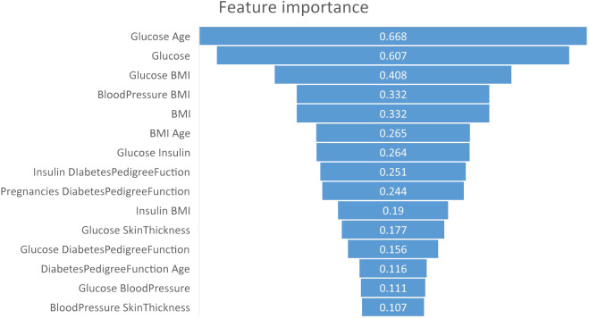
OUTPUT

Slide 6
CONCLUSION
After using all these patient records, we are able to build a machine learning model (random forest – best one) to accurately predict whether or not the patients in the dataset have diabetes or not along with that we were able to draw some insights from the data via data analysis and visualization.

Slide 7
COMPARISON
ADVANTAGES
DISADVANTAGES
Reduce in human errors
Helps in lessening repetitve work
Provides digital assistance
Faster and more accurate decisions
Cost Overruns
Dearth of talent
Lack of practical products
Potential for misuse

